Slide 1
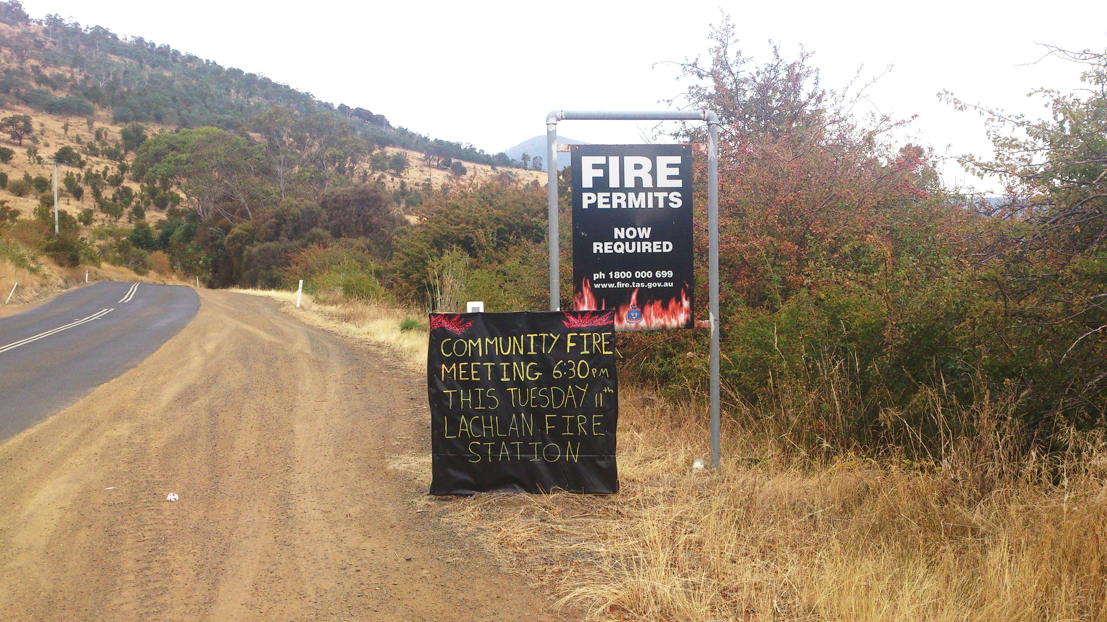

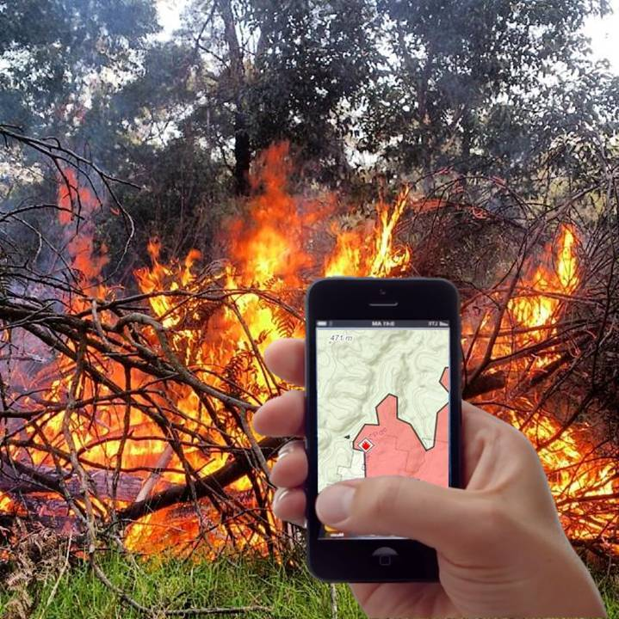


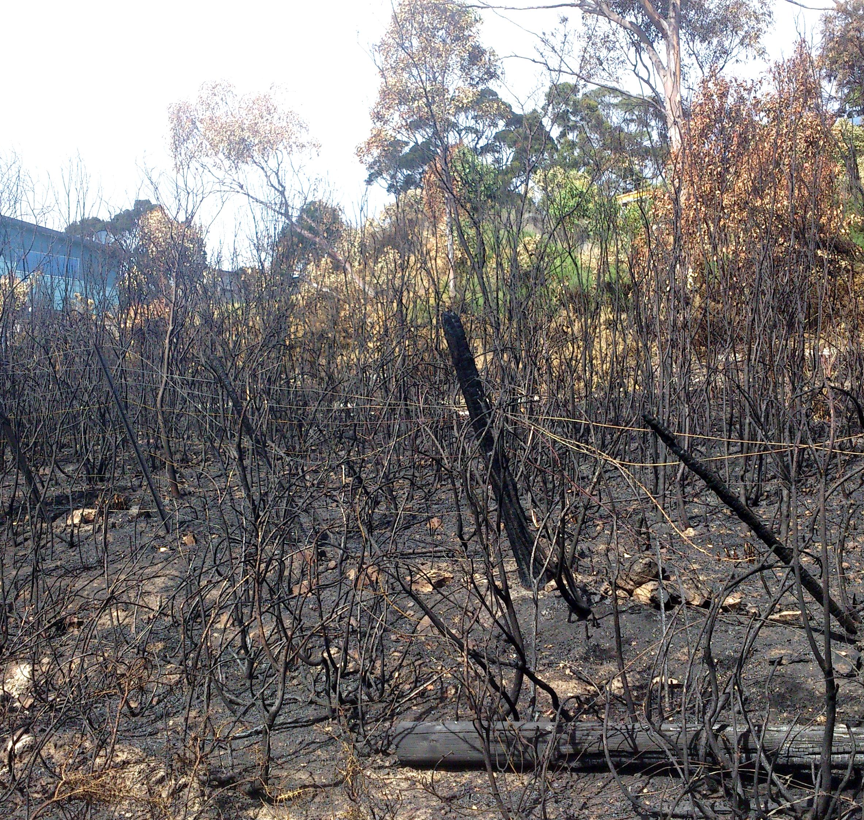


Non-traditional volunteering:
Volunteered geographic information (VGI) and bushfire preparation
Billy Haworth¹, Eleanor Bruce¹, Joshua Whittaker²
¹ School of Geosciences, University of Sydney, NSW ² Math & Geospatial Sciences, RMIT, VIC
VGI involves the widespread engagement of the general public in generating and disseminating geographic information, predominantly through sources such as social media, photo and video sharing platforms, and online map-making software. This research explores the potential role of VGI for fostering community engagement in bushfire preparation and building individual empowerment and disaster resilience in Tasmania.
Project Background
The recent emergence of VGI is increasingly providing authorities an effective method for engaging with high risk, vulnerable and impacted communities. Authorities and individuals have begun to embrace VGI technologies, creating a new landscape of geo-data production and knowledge sharing for crisis events. VGI enables rapid sharing of diverse geographic information for disaster management at a fraction of the resource costs associated with traditional data collection and dissemination, and facilitates increased connectedness between individuals and authorities. However, VGI also raises important concerns relating to privacy, security, liability, data accuracy and credibility.
Much work on the role of VGI in disasters to date has focussed on response, creating a need for research in the pre-disaster phases of the disaster management cycle. Research has shown communities often feel disempowered and may not engage in disaster preparedness activities. This study provides an evidence base for the utilisation of VGI technologies in bushfire preparation initiatives, where VGI may offer a platform to build resilience through increased community engagement and connectedness.
Key preliminary findings
The proportion of people actively involved in risk reduction is significantly lower than those who identify themselves as at-risk
There is high potential and interest in VGI technologies and social media for assisting with bushfire preparation amongst community members
But limitations exist, such as age, reliable access to technology, and trust
Spatially, higher levels of social media use occur around larger urban centres
Strong preferences are still present among respondents generally for other forms of disaster communication, such as TV, radio, phone/SMS or official websites
VGI should not aim to replace traditional methods, but can act as an additional tool for increasing awareness of bushfire preparedness, and to empower individuals to engage in preparation activities by contributing important local information.
Wider significance
This research is important as authorities seek new ways to engage communities in increasing bushfire preparedness. VGI technologies are already being used by individuals and emergency management agencies, and the impacts of these data and data sharing practices need to be understood.
The issues raised in this study, particularly those of data credibility, trust, reliability, and the increasing role of the general public as information observers and sharers, are not just relevant to bushfire preparedness in Tasmania, but are pertinent to disaster management, geo data and social practices, and the discipline of geography more broadly.
Image: Glenn Hunt, brw.com.au
A Working partnership
This work is being undertaken in collaboration with the Tasmania Fire Service and the Bushfire Ready Neighbourhoods facilitator, Mr Peter Middleton. An initial Tasmania-wide survey of 154 respondents across 12 high risk communities has provided insight into patterns of individual and community preparedness, social media and VGI use, and communication amongst community members and between communities and bushfire authorities.
© BUSHFIRE AND NATURAL HAZARDS CRC 2014

